Slide 1

Greedy Algorithms
Yongcai Wang
Renmin University of China

Slide 2
Today
One example of a greedy algorithm that does not work:
Knapsack problem
Five examples of greedy algorithms that do work:
Activity Selection/Interval Scheduling
Interval Partitioning
Maximum Lateness Minimization Scheduling
Sum Penalty Minimization Scheduling
Huffman Coding

Slide 3

主要内容
Greedy algorithm doesn’t work
Activity Selection/Interval Scheduling
Interval Partitioning
Max Lateness Minimization Scheduling
Greedy Algorithm
Proof of Optimality, Optimal sub-structure
Algorithm and Proof of Optimality
Knapsack problem
Algorithm and Proof of Optimality
Sum Penalty Minimization Scheduling
Huffman Coding
Algorithm and Proof of Optimality
Algorithm and proof of optimality
Matroid

Slide 4
Item:
Weight:
6
2
4
3
11
Capacity: 10
Value:
20
8
14
13
35
“Greedy” algorithm for unbounded knapsack:
Tacos have the best Value/Weight ratio!
Keep grabbing tacos!
Unbounded Knapsack:
Suppose I have infinite copies of all items.
What’s the most valuable way to fill the knapsack?
Total weight: 9
Total value: 39
Total weight: 10
Total value: 42

Slide 5
Activity Selection/Interval Scheduling
We are given a set R of n activities. Each activity has a given start time s_{i} and a given finish time f_{i}.
Two requests i and j conflict if their start-finish intervals overlap:
The problem is to determine a subset of R of maximum cardinality consisting of requests that are mutually non-conflicting.

Slide 6
Example where greedy works Activity selection
CS 161 Class
Math 51 Class
CS 161 Section
Sleep
Frisbee Practice
You can only do one activity at a time, and you want to maximize the number of activities that you do.
What to choose?
CS 161 Office Hours
Theory Seminar
Orchestra
Programming team meeting
CS 166 Class
Underwater basket weaving class
CS110 Class
CS161 study group
Swimming lessons
Theory Lunch
Combinatorics Seminar
Social activity
time

Slide 7
Activity Selection/Interval Scheduling
A simple example and two possible optimal solutions:

Slide 8
A number ideas can be used.
Earliest Activity First: Repeatedly select the activity with the earliest start time that is not conflicting with early scheduled activities.
Shortest Activity First: Repeatedly select the activity with the smallest duration (f_{i} −s_{i}), that is not conflicting with early scheduled activities.
Lowest Conflict Activity First: Repeatedly select the activity that conflicts with the smallest number of remaining activities.
Show (by producing a counterexample) that each of the above strategies may not generate an optimal solution.

Slide 9
什么样的贪心算法能给出最优解？
贪心策略适用的前提是：局部最优策略能导致产生全局最优解。
贪心算法以迭代的方式作出相继的贪心选择，每作一次贪心选择就将所求问题简化为规模更小的子问题。
对于一个具体问题，要确定它是否具有贪心选择性质，必须证明每一步所作的贪心选择最终形成整体最优解。

Slide 10
什么样的贪心算法能给出最优解？
没有通用的方法可以确定贪婪算法是否是最优的，但是如下两个规则可以用于分析贪心算法的最优性：
贪心选择性质（Greedy Choice Property）：在每一步选择中，都能够选择一个局部最优解，而这个选择不会对剩余的问题产生负面影响。
最优子结构性质（Optimal Substructure Property）：通过解决子问题的最优解，可以构建出原问题的最优解。

Slide 11
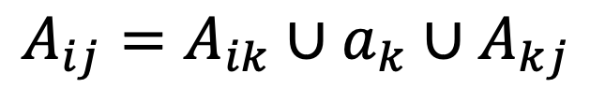
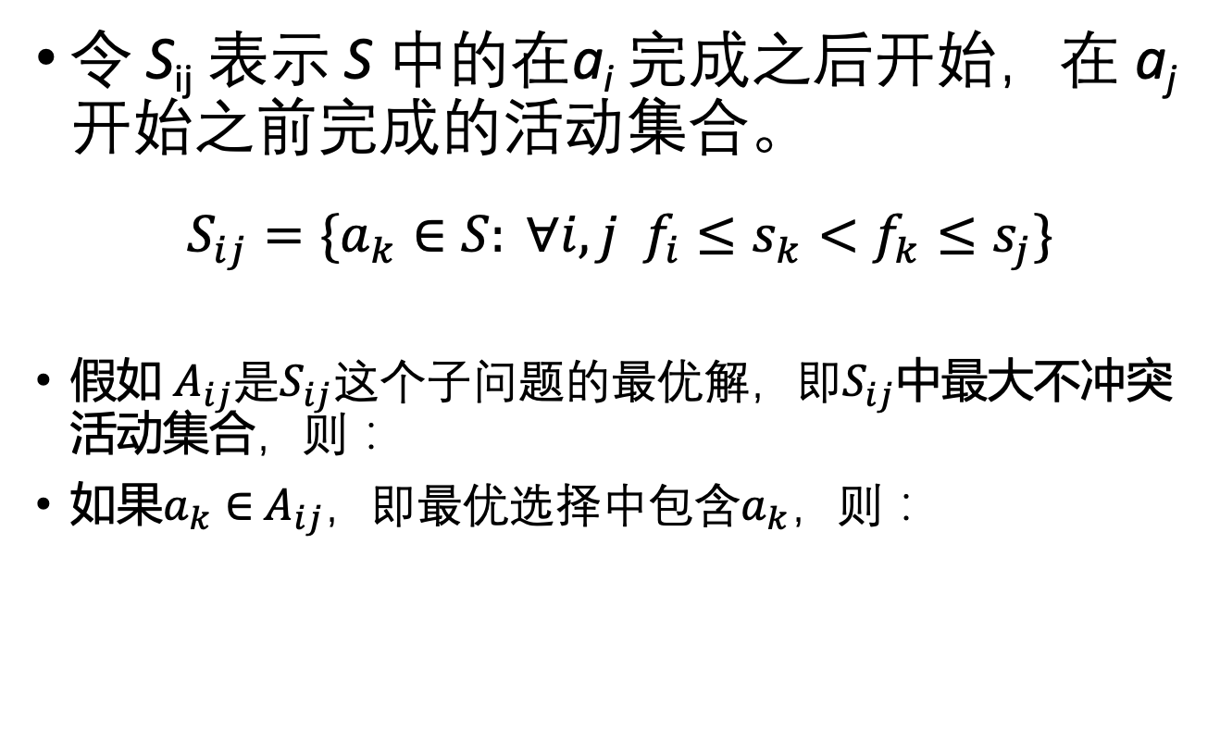
活动选择的问题结构
令 S_{ij} 表示 S 中的在a_{i} 完成之后开始，在 a_{j} 开始之前完成的活动集合。
$$S_{ij}=\left.\{a_{k}∈S: ∀i, j f_{i}≤s_{k}<f_{k}≤s_{j}\right.\}$$
假如 $A_{ij}$是$S_{ij}这个子问题的最优解，即S_{ij}$中最大不冲突活动集合，则：
如果$a_{k}∈$ $A_{ij}，即最优选择中包含a_{k}$，则：
$$A_{ij}=A_{ik}∪a_{k}∪A_{kj}$$

Slide 12

递归表达
子问题：从$S_{ij}$中选出最多的不冲突事件。
用c[i,j]表示$S_{ij}$中选出的最多的不冲突事件的数量。
需要遍历k，才能找出c[i,j]的最优值。

Slide 13

递归表达的复杂度
n个事件
1个
n-1个事件
1个
1个
n-2个事件
2个
1个
n-3个事件
1个
n-2个事件
1个
1个
n-3个事件
2个
1个
n-4个事件
会产生指数数量的递归调用

Slide 14
活动选择问题的最优子结构
活动选择问题有一个自然的最优子结构:
A[i] = number of activities you can do after the end of activity i
子问题集合是去掉与i冲突的活动后剩余的活动选择问题。
如何设计一个局部最优方案？
在尽量早的时间里完成尽量多的活动。
A[i] = solution to this sub-problem
a_{k}
a_{i}
a₃
a₇
a_{j}
a₂
a₆
time

Slide 15
贪心算法一般设计容易，但是分析最优性不易，设计与分析的流程：
分析问题的子结构性质
设计一种局部最优的贪心机制
给出贪心算法
分析算法复杂度
证明算法正确性
分析证明此贪心机制是否产生全局最优方案

Slide 16
局部最优贪心机制: Earliest Finish First (EFF)
a₅
a₁
a₃
a₇
a₄
a₂
a₆
time
Pick activity you can add with the smallest finish time.
Repeat.

Slide 17
局部最优贪心机制: Earliest Finish First (EFF)
a₅
a₁
a₃
a₇
a₄
a₂
a₆
time
Pick activity you can add with the smallest finish time.
Repeat.

Slide 18
局部最优贪心机制: Earliest Finish First (EFF)
a₅
a₁
a₃
a₇
a₄
a₂
a₆
time
Pick activity you can add with the smallest finish time.
Repeat.

Slide 19
局部最优贪心机制: Earliest Finish First (EFF)
a₅
a₁
a₃
a₇
a₄
a₂
a₆
time
Pick activity you can add with the smallest finish time.
Repeat.

Slide 20
局部最优贪心机制: Earliest Finish First (EFF)
a₅
a₁
a₃
a₇
a₄
a₂
a₆
time
Pick activity you can add with the smallest finish time.
Repeat.

Slide 21
局部最优贪心机制: Earliest Finish First (EFF)
a₅
a₁
a₃
a₇
a₄
a₂
a₆
time
Pick activity you can add with the smallest finish time.
Repeat.

Slide 22
局部最优贪心机制: Earliest Finish First (EFF)
a₅
a₁
a₃
a₇
a₄
a₂
a₆
time
Pick activity you can add with the smallest finish time.
Repeat.

Slide 23
局部最优贪心机制: Earliest Finish First (EFF)
a₅
a₁
a₃
a₇
a₄
a₂
a₆
time
Pick activity you can add with the smallest finish time.
Repeat.

Slide 24
局部最优贪心机制:算法
greedyIntervalSchedule(s, f) {
Sort tasks by increasing order of finish times
S = empty
prev_finish = -infinity
for (i = 1 to n) {
if (s[i] > prev_finish) {
append task i to S
prev_finish = f[i]
}
}
return S
}
//基于完成时间排序
//save the scheduled activities
//finish time of previous task
//避免冲突

Slide 25
EFF贪心算法的问题子结构
n个事件
i个
n-i个事件
k个
n-i-k个事件
最多发生n次调用：O(n)

Slide 26
Complexity and Correctness
The time complexity is O(nlogn)
The running time is dominated by the O(nlogn) time to sort the jobs by their finish times.
After sorting, the remaining steps can be performed in O(n) time.
The correctness
The output is a valid schedule that no two conflicting tasks appear in the final schedule.
The optimality is proved in the following slides, which is worth noting, because it is common to many correctness proofs for greedy algorithms.

Slide 27
贪心算法最优性证明的方法
We begin by considering an arbitrary solution, which may assume to be an optimal solution.
If it is equal to the greedy solution, then the greedy solution is optimal.
Otherwise, we consider the first instance where these two solutions differ.
We replace the optimal choice with the greedy choice and show that things can only get better.
Thus, by applying this argument inductively, it follows that the greedy solution is as good as an optimal solution, thus it is optimal.

Slide 28
Proof of Optimality
Let O = ⟨x₁, . . . , x_{k}⟩ be the activities of an optimal solution listed in increasing order of finish time,
Let G = ⟨g₁, . . . , g_{k′} ⟩ be the activities of the EFF solution similarly sorted.
If G = O, then we are done.
Otherwise, observe that since O is optimal, it must contain at least as many activities as the greedy schedule.
Suppose there is a first index j where these two schedules differ

Slide 29
Proof of Optimality
The optimal schedule
The greedy schedule
g_{j} does not conflict with any earlier activity, and its finish time is no later than x_{j}, for the greedy earliest finish time policy.
Construct a modified schedule O’ by replacing x_{j} in O by g_{j}
O′ is a valid schedule, because g_{j} finishes no later than x_{j}, so it will not conflict with later schedules in O.

Slide 30
Proof of Optimality
This new schedule has the same number of activities as O, and so it is at least as good with respect to our optimization criterion.
By repeating this process, we will eventually convert O into G without ever decreasing the number of activities. It follows that G is optimal.

Slide 31
One Common strategy for showing we don’t rule out success
Suppose that you’re on track to make an optimal solution T*.
E.g., after you’ve picked activity i, you’re still on track.
Suppose that T* disagrees with your next greedy choice.
E.g., it doesn’t involve activity k.
Manipulate T* in order to make a solution T that’s not worse but that agrees with your greedy choice.
E.g., swap whatever activity T* did pick next with activity k.

Slide 32
Note on “Common Strategy”
This common strategy is not the only way to prove that greedy algorithms are correct!
It often works, and it gives you a framework to get started.
There is a mathematical subject called “matroid theory”. Often (but not always) when greedy algorithms work correctly, matroid theory can explain why. CLRS has a small section on this.

Slide 33
Sub-problem graph view
Greedy algorithms:
Big problem
sub-problem
sub-sub-problem

Slide 34
Sub-problem graph view
Greedy algorithms:
Big problem
Not only is there optimal sub-structure:
optimal solutions to a problem are made up from optimal solutions of sub-problems
but each problem depends on only one sub-problem.
sub-problem
Write a DP version of activity selection (where you fill in a table)! [See hidden slides in the .pptx file for one way]
sub-sub-problem
Ollie the Over-achieving Ostrich

Slide 35
主要内容
Greedy algorithm doesn’t work
Activity Selection/Interval Scheduling
Interval Partitioning
Max Lateness Minimization Scheduling
Greedy Algorithm
Proof of Optimality, Optimal sub-structure
Algorithm and Proof of Optimality
Knapsack problem
Algorithm and Proof of Optimality
Sum Penalty Minimization Scheduling
Huffman Coding
Algorithm and Proof of Optimality
Algorithm and proof of optimality
Matroid

Slide 36
Matriod：拟阵
让 S 是一个有限集合，F 是 S 的子集的一个非空集族，即 F ⊆ P(S)。我们称 (S,F) 是一个拟阵（matroid），当且仅当：
1) 如果 B ∈ F 且 A ⊆ B，则 A ∈ F。 [这个族 F 被称为遗传的]
2) 如果 A, B ∈ F 且 |A| < |B|，那么存在 x ∈ B\A 使得 A∪{x} ∈ F。 [这被称为交换性质]

Slide 37
矩阵拟阵
设 M 是一个矩阵，S是M的行向量的集合
F = { A | A⊆S, A 是线性无关的集合 }
则：(S,F) 是一个拟阵。
证明，F 不为空（它包含 M 的每一行）。
1) 如果 B 是 M 的线性无关行的集合，则 B 的任意子集 A 也是线性无关的。因此，F 是遗传的。
2) 如果 A, B 是 M 的线性无关行的集合，并且 |A|<|B|，那么 dim span A < dim span B。选择 B 中不在 span A 中的行 x。那么 A∪ {x} 是 M 的行的一个线性无关子集。因此，F 满足交换性质。

Slide 38
无向图
设 V 为一个有限集合，
E 是 { e | e ⊆ V, |e|=2 } 的一个子集。
那么 (V,E) 被称为一个无向图。
我们将 V 称为图的顶点集，E 称为图的边集。
V = {a,b,c,d}
E = { {a,b}, {a,c}, {a,d}, {b,d}, {c,d} }

Slide 39
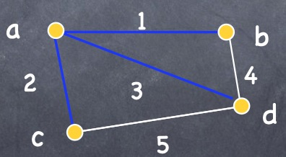
生成树
设 G=(V,E) 是一个图。
如果它的边集 E’ 是 E 的子集，则称图 (V,E’) 是 G 的诱导子图。
因此，图 G=(V,E) 的诱导子图具有相同的顶点集 V，并且没有不在 E 中的边。
给定一个连通图 G，G 的一个生成树是 G 的一个诱导子图，且恰好是一棵树，并连接 G 的所有顶点。如果边带有权重，则 G 的一棵权重最小的生成树称为最小生成树。

Slide 40
图拟阵
设 G=(V,E) 是一个无向图。
选择 S = E 和 F = { A | H = (V,A) 是 G 的诱导子图，且 H 是一个森林 }。
则 (S,F) 是一个拟阵
1）很显然F 是一个非空的遗传集合系统。
2）假设 A 和 B 是 F 中的集合，且 |A| < |B|。那么 (V,B) 比 (V,A) 有更少的树。因此，(V,B) 必须包含一个树 T，其顶点位于森林 (V,A) 中不同的树中。可以将连接两个不同树的边 x 添加到 A 中，并得到另一个森林 (V,A∪{x})。

Slide 41
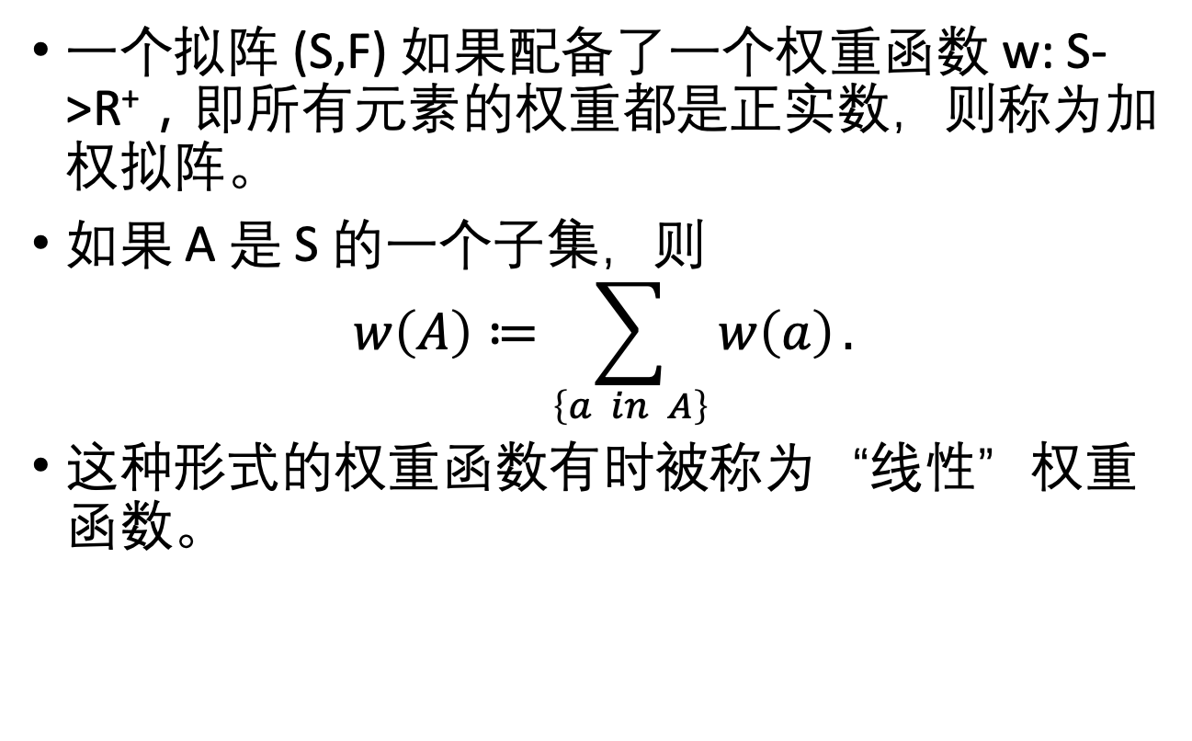
加权函数
一个拟阵 (S,F) 如果配备了一个权重函数 w: S->R⁺，即所有元素的权重都是正实数，则称为加权拟阵。
如果 A 是 S 的一个子集，则
$$w\left(A\right)≔\sum_{\left\{a in A\right\}}{w\left(a\right)}.$$
这种形式的权重函数有时被称为“线性”权重函数。

Slide 42
最大权重子集贪心算法
贪婪算法(Greedy)（M=(S,F),w） // 最大化版本
A := ∅;
按权重 w 的单调递减顺序对 S 进行排序。
for x in S 按单调递减顺序取出，
if A∪{x} 在 F 中
A := A∪{x};
endfor
返回 A;

Slide 43
拟阵上贪心算法的正确性
定理：假设 M= (S,F) 是一个带有权重函数 w 的加权拟阵，则Greedy(M,w) 返回一个权重最大的 F 中的集合。
因此，尽管一般情况下贪心算法不能产生最优结果，但对于拟阵的贪心算法确实可以！这个算法适用于广泛的问题类别。
对于贪心算法的正确性证明同前面的证明过程相同。

Slide 44
正确性证明
用反证法证明：
假设贪心算法返回了 F 中的集合 C，但存在 F 中的另一个集合 B，使得 w(B) > w(C)。
由于 w 是非负的，我们可以假设 B 和 C 是基。设 B= {b₁,...,b_{n}} 和 C={c₁,...,c_{n}}。
设 i 是最小的索引，使得 w(b₁)<=w(c₁),...,w(b_{i-1})<=w(ci-1)，且 w(b_{i})>w(c_{i})。
贪心算法在第 i 步会选择 b_{i}。 由于{b₁,...,b_{i}} 和 {c₁,...,c_{i-1}} 在 F 中，因此根据拟阵的交换性质，{c₁,...,c_{i-1},b_{i}} 也在 F 中。因此 w(B)<=w(C)，矛盾！

Slide 45
图拟阵
让 G=(V,E) 为一个无向连通图。
令 S = E，F = { A | H = (S,A) 是 G 的诱导子图，且 H 为森林 }。
令 w 为边 E 上的权重函数。
定义 w'(a)=m-w(a)，其中 m>w(a)，对于所有 a 属于 A。
Greedy((S,F), w’) 返回 G 的最小生成树。这个算法被称为 Kruskal 算法。

Slide 46
主要内容
Greedy algorithm doesn’t work
Activity Selection/Interval Scheduling
Interval Partitioning
Max Lateness Minimization Scheduling
Greedy Algorithm
Proof of Optimality, Optimal sub-structure
Algorithm and Proof of Optimality
Knapsack problem
Algorithm and Proof of Optimality
Sum Penalty Minimization Scheduling
Huffman Coding
Algorithm and Proof of Optimality
Algorithm and proof of optimality
Matroid

Slide 47
Schedule to Minimize the Sum Lateness Penalty
CS161 HW
Personal hygiene
Math HW
Administrative stuff for student club
Econ HW
Do laundry
Meditate
Practice musical instrument
Read lecture notes
Have a social life
Sleep

Slide 48

Scheduling
n tasks
Task i takes t_{i} hours
For every hour that passes until task i is done, pay c_{i}
CS161 HW, then Sleep: costs 10 $⋅$ 2 + (10 + 8) $⋅$ 3 = 74 units
Sleep, then CS161 HW: costs 8 $⋅$ 3 + (10 + 8) $⋅$ 2 = 60 units
10 hours
Cost: 2 units per hour until it’s done.
CS161 HW
Sleep
Cost: 3 units per hour until it’s done.
8 hours

Slide 49
Optimal substructure
This problem breaks up nicely into sub-problems:
Suppose this is the optimal schedule:
Job A
Job B
Job C
Job D
Then this must be the optimal schedule on just jobs B,C,D.
Why?
Think-share
1 minute think
(wait) 1 minute share

Slide 50
Optimal substructure
This problem breaks up nicely into sub-problems:
Suppose this is the optimal schedule:
Job A
Job B
Job C
Job D
Then this must be the optimal schedule on just jobs B,C,D.
If not, then rearranging B,C,D could make a better schedule than (A,B,C,D)!

Slide 51
Optimal substructure
Seems amenable to a greedy algorithm:
Take the best job first
Then solve this problem
Job A
Job B
Job C
Job D
Take the best job first
Then solve this problem
Job C
Job B
Job D
Take the best job first
Then solve this problem
Job D
Job B
(That one’s easy ☺ )

Slide 52

Which schedule is better?
Of these two jobs, which should we do first?
Cost( A then B ) = t$a⋅$c_{a} + (t$a$ + t$b$) $⋅$ c_{b}
Cost( B then A ) = t$b$ $⋅$c_{b} + (t$a$ + t$b$) $⋅$c_{a}
t_{a} hours
Job A
Cost: c_{a} units per hour until it’s done.
Job B
Cost: c_{b} units per hour until it’s done.
t_{b} hours

Slide 53
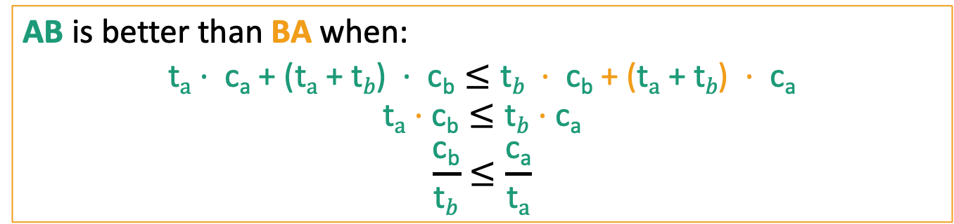
Which schedule is better?
t_{a} hours
t_{b} hours
Job A
Job B
Cost: c_{a} per hour
Cost: c_{b} per hour
t_{b} hours
t_{a} hours
Job B
Job A
Cost: c_{b} per hour
Cost: c_{a} per hour
AB is better than BA when:
$$\text{t}a⋅ \text{c}\text{a}\text{ + (}\text{t}a\text{ + }\text{t}b\text{) }⋅ \text{cb}≤\text{t}b ⋅ \text{c}\text{b}\text{ + (}\text{t}a\text{ + }\text{t}b\text{) }⋅ \text{c}\text{a}$$
$$\text{t}a⋅\text{c}\text{b}≤\text{t}b⋅\text{c}\text{a}$$
$$\frac{\text{c}\text{b}}{\text{t}b}≤\frac{\text{c}\text{a}}{\text{t}a}$$
Schedule the one with larger cost/time ratio earlier will be better.

Slide 54
Lemma This greedy choice doesn’t rule out success
Suppose you have already chosen some jobs, and haven’t yet ruled out success:
Then if you choose the next job to be the one left that maximizes the ratio cost/time, you still won’t rule out success.
Proof sketch:
Say Job B maximizes this ratio, but it’s not the next job in the opt. soln.
Already chosen E
There’s some way to order A, B,C, D that’s optimal…
Job E
Job C
Job A
Job B
Job D
Say greedy chooses job B
How can we manipulate the optimal solution above to make an optimal solution where B is the next job we choose after E?
1 minute think; (wait) 1 minute share

Slide 55
Lemma This greedy choice doesn’t rule out success
Suppose you have already chosen some jobs, and haven’t yet ruled out success:
Then if you choose the next job to be the one left that maximizes the ratio cost/time, you still won’t rule out success.
Proof sketch:
Say Job B maximizes this ratio, but it’s not the next job in the opt. soln.
Switch A and B! Nothing else will change, and we just showed that the cost of the solution won’t increase.
Already chosen E
There’s some way to order A, B,C, D that’s optimal…
Job E
Job C
Job A
Job B
Job D
Say greedy chooses job B
Job E
Job C
Job B
Job A
Job D
We have just proved that schedule the one with larger cost/time ratio earlier will be better, so the swap to schedule Job B earlier will not increase the total cost.

Slide 56
Proof of the Lemma
Job E
Job B
Job C
Job A
Job D
We continue to swap task until Job B is the next scheduled Job, like the greedy method.
We have just proved that schedule the one with larger cost/time ratio earlier will be better, so all the swaps will not increase the total cost.
By repeatedly modifying the optimal schedule, we see the greedy method will not increase the total cost, which is therefore optimal.

Slide 57

Greedy Scheduling Solution
scheduleJobs( JOBS ):
Sort JOBS in decreasing order by the ratio:
$r_{i}=\frac{c_{i}}{t_{i}}= \frac{\text{cost} \text{of} \text{delaying} \text{job} \text{i} }{\text{t}\text{ime} \text{job} \text{i} \text{takes} \text{to} \text{complete}}$
Return JOBS
Running time: O(n log(n))
Now you can go about your schedule peacefully, in the optimal way.

Slide 58
主要内容
Greedy algorithm doesn’t work
Activity Selection/Interval Scheduling
Interval Partitioning
Max Lateness Minimization Scheduling
Greedy Algorithm
Proof of Optimality, Optimal sub-structure
Algorithm and Proof of Optimality
Knapsack problem
Algorithm and Proof of Optimality
Sum Penalty Minimization Scheduling
Huffman Coding
Algorithm and Proof of Optimality
Algorithm and proof of optimality
Matroid

Slide 59
Interval Partitioning
Given the activities, we want to schedule all the activities using the smallest number resources.
We are given a collection R of n activity requests, each with a start and finish time [s_{i},f_{i}].
The objective is to find the smallest number d to partition R into d disjoint subsets R₁, . . . , R_{d}, such that the events of R_{j} are mutually nonconflicting, for each j, 1 ≤ j ≤ d.

Slide 60
Interval Partitioning
We can view this as a coloring problem.
we want to assign colors to the activities such that two conflicting activities must have different colors.
Our objective is to find the minimum number of colors, such that it is possible to color each of the activities in this manner.

Slide 61
Solving this coloring problem
Coloring problems are hard to solve efficiently.
Due to the simple nature of intervals, it is possible to solve the interval partitioning problem quite efficiently by a simple greedy approach.
First, we sort the requests by increasing order of start times.
We then assign each request the smallest color (possibly a new color) such that it conflicts with no other requests of this color class.

Slide 62
Greedy Interval Partitioning Algorithm
greedyIntervalPartition(s, f) { // schedule tasks with given start/finish times
sort requests by increasing start times
for (i = 1 to n) do { // classify the ith request
E = emptyset // E stores excluded colors for activity i
for (j = 1 to i-1) do {
if ([s[j],f[j]] overlaps [s[i],f[i]]) add color[j] to E
}
Let c be the smallest color NOT in E
color[i] = c
}
return color[1...n]
}

Slide 63
Running time complexity
The algorithm’s running time is O(n²)
If we relax the requirement that the color be the smallest available color (instead allowing any available color), it is possible to reduce this to O(n log n) time with a bit of added cleverness.
See Mount’s lecture notes.

Slide 64
Correctness
We first observe that the algorithm never assigns the same color to two conflicting activities.
Thus, the algorithm produces a valid coloring.
The question is whether it produces an optimal coloring, i.e., the minimum number of distinct colors.
How to prove?
To establish this, we will introduce a helpful quantity.

Slide 65
Proof of Optimality
Define depth(t) to be the number of activities whose start-finish interval contains t.
Given a set R of activity requests, define depth(R) to be the maximum depth over all possible values of t.
Given any instance R of the interval partitioning problem, the number of resources needed is at least depth(R).
if d denotes the minimum number of colors in any schedule, we have d ≥ depth(R).

Slide 66
Proof of Optimality
Theorem: given any instance R of the interval partitioning problem, the number of resources produced by the greedy partitioning algorithm is at most depth(R).
Proof
We simplify the proof to assume that all start and finish times are distinct.
To prove: Greedy allocates d colors, then we need at least d.
Color d open because interval j incompatible with d-1 others.
All these incompatibilities are caused by intervals that start no later than sj
Thus d intervals are overlapping at time s_{j}+ε.
By “number of colors > depth(R)”, we know we need at least d colors, where d is at most depth(R).

Slide 67
主要内容
Greedy algorithm doesn’t work
Activity Selection/Interval Scheduling
Interval Partitioning
Max Lateness Minimization Scheduling
Greedy Algorithm
Proof of Optimality, Optimal sub-structure
Algorithm and Proof of Optimality
Knapsack problem
Algorithm and Proof of Optimality
Sum Penalty Minimization Scheduling
Huffman Coding
Algorithm and Proof of Optimality
Algorithm and proof of optimality
Matroid

Slide 68
Scheduling to Minimize the Maximum Lateness
Scheduling a set of n tasks where each task is associated with an execution time t_{i} and a deadline d_{i}.
The objective is to schedule the tasks, no two overlapping in time, and minimize the maximum lateness over all the tasks.
Define the the finish time of the ith task to be f_{i} = s_{i} + t_{i} , the lateness of the ith task is l_{i} = max(0, f_{i} − d_{i})
The maximum lateness of S is defined to be
The overall objective is to compute S that minimizes L(S).

Slide 69
Scheduling to Minimize the Maximum Lateness

Slide 70
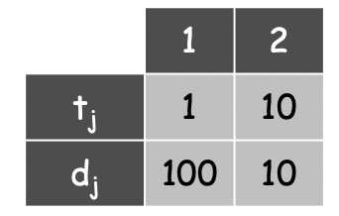
Greedy Algorithm that minimizes the maximum lateness
Smallest duration first: Sort tasks by increasing order of execution times t_{i} and schedule them in this order.
运行时间和deadline不是耦合的，可能运行时间短的deadline还比较晚，运行时间长的deadline比较早。
反例：

Slide 71
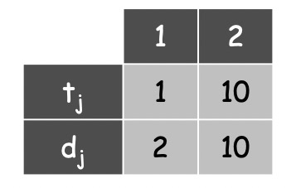
Greedy Algorithm that minimizes the maximum lateness
Smallest slack-time first: Define the slack time of task x_{i} as d_{i} − t_{i} . This statistic indicates how long we can safely wait before starting a task. Schedule the tasks in increasing order of slack-time.
反例：
运行时间和deadline不是耦合的，Slack time大，有可能是因为运行时间长，而deadline很近。
Lateness = 9
t₂
t₁
0
1
2
3
4
5
6
7
8
9
10
11
12
12
14
15
16

Slide 72
Greedy Algorithm that minimizes the maximum lateness
Earliest Deadline First (EDF) strategy: schedule jobs in ascending order of deadline d_{j}
Lateness = 1
t₁
t₂
0
1
2
3
4
5
6
7
8
9
10
11
12
12
14
15
16

Slide 73
Earliest Deadline First (EDF) strategy
Sorting the tasks by their deadline, and then schedule them in this order.
greedySchedule(t, d) {
sort tasks by increasing deadline (d[1] <= ... <= d[n])
f_prev = 0 // f is the finish time of previous task
for (i = 1 to n) do {
assign task i to start at s[i] = f_prev // start next task
f_prev = f[i] = s[i] + t[i] // its finish time
lateness[i] = max(0, f[i] - d[i]) // its lateness
}
return array s // return array of start times
}
Time complexity is O(nlogn)

Slide 74
Correctness and optimal
Let G be the schedule produced by the greedy algorithm, and let O be any optimal idle-free schedule.
If G = O, then greedy is optimal, and we are done.
Otherwise, O must contain at least one inversion, that is, at least one pair of tasks that have not been scheduled in increasing order of deadline.
Let us consider the first instance of such an inversion. That is, let x_{i} and x_{j} be the first two consecutive tasks in the schedule O such that d_{j} < d_{i}.

Slide 75
Proof of Optimality
The schedules O and G are identical up to these two tasks
d_{j} < d_{i} (and therefore x_{j} is scheduled before x_{i} in schedule G)
x_{i} is scheduled before x_{j} in schedule O
Swapping x_{i} and x_{j} in O, the maximum lateness cannot increase.

Slide 76
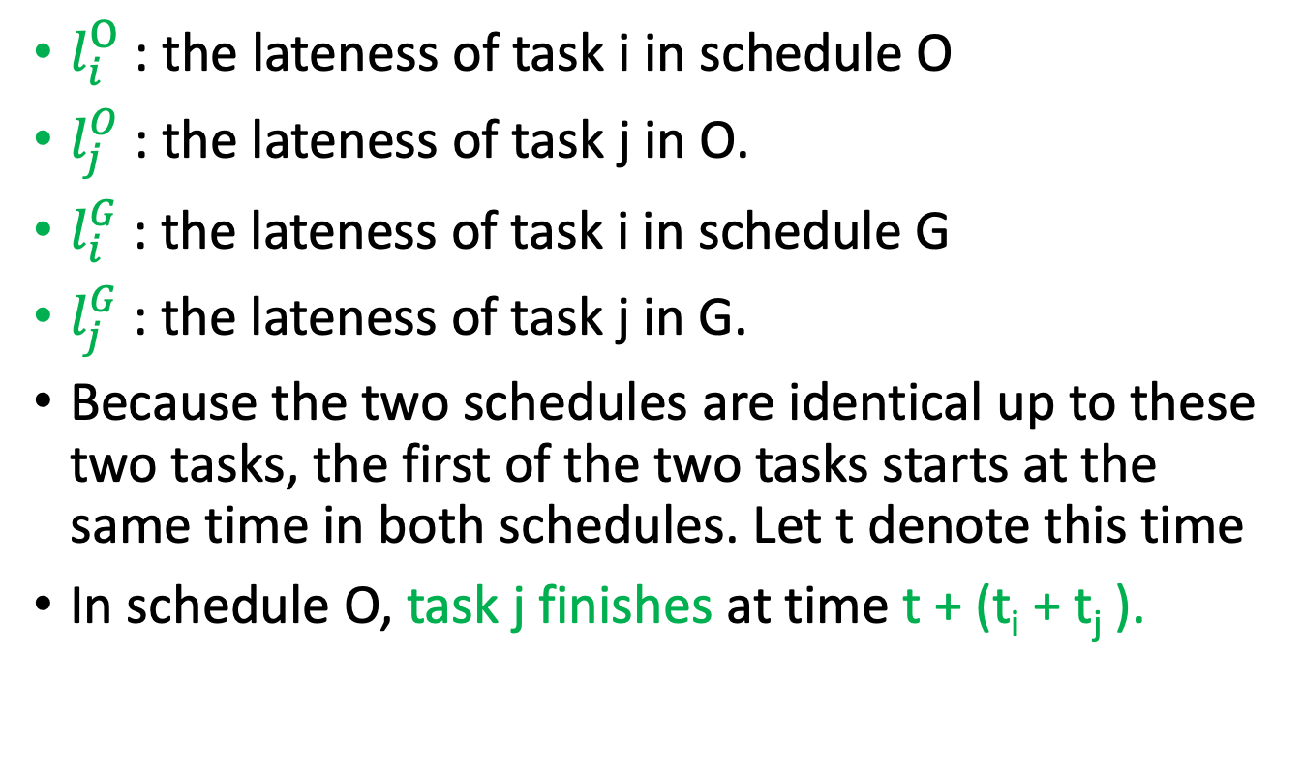
Proof of Optimality
$l_{i}^{O}$: the lateness of task i in schedule O
$l_{j}^{O}$: the lateness of task j in O.
$l_{i}^{G}$: the lateness of task i in schedule G
$l_{j}^{G}$: the lateness of task j in G.
Because the two schedules are identical up to these two tasks, the first of the two tasks starts at the same time in both schedules. Let t denote this time
In schedule O, task j finishes at time t + (t_{i} + t_{j} ).

Slide 77
Proof of Optimality
Applying a similar analysis to G, we have
Therefore we have:
The greedy scheduling algorithm minimizes the maximum lateness.

Slide 78
主要内容
Greedy algorithm doesn’t work
Activity Selection/Interval Scheduling
Interval Partitioning
Max Lateness Minimization Scheduling
Greedy Algorithm
Proof of Optimality, Optimal sub-structure
Algorithm and Proof of Optimality
Knapsack problem
Algorithm and Proof of Optimality
Sum Penalty Minimization Scheduling
Huffman Coding
Algorithm and Proof of Optimality
Algorithm and proof of optimality

Slide 79
One more example Huffman coding
everyday english sentence
01100101 01110110 01100101 01110010 01111001 01100100 01100001 01111001 00100000 01100101 01101110 01100111 01101100 01101001 01110011 01101000 00100000 01110011 01100101 01101110 01110100 01100101 01101110 01100011 01100101
qwertyui_opasdfg+hjklzxcv
01110001 01110111 01100101 01110010 01110100 01111001 01110101 01101001 01011111 01101111 01110000 01100001 01110011 01100100 01100110 01100111 00101011 01101000 01101010 01101011 01101100 01111010 01111000 01100011 01110110

Slide 80
One more example Huffman coding
ASCII is pretty wasteful for English sentences. If e shows up so often, we should have a shorter way of representing it!
everyday english sentence
01100101 01110110 01100101 01110010 01111001 01100100 01100001 01111001 00100000 01100101 01101110 01100111 01101100 01101001 01110011 01101000 00100000 01110011 01100101 01101110 01110100 01100101 01101110 01100011 01100101
qwertyui_opasdfg+hjklzxcv
01110001 01110111 01100101 01110010 01110100 01111001 01110101 01101001 01011111 01101111 01110000 01100001 01110011 01100100 01100110 01100111 00101011 01101000 01101010 01101011 01101100 01111010 01111000 01100011 01110110

Slide 81
Suppose we have some distribution on characters

Slide 82
Suppose we have some distribution on characters
For simplicity, let’s go with this made-up example
How to encode them as efficiently as possible?
45
Percentage
A
16
D
13
B
12
9
C
E
5
F
Letter

Slide 83
Try 0 (like ASCII)
Every letter is assigned a binary string of three bits.
Wasteful!
110 and 111 are never used.
We should have a shorter way of representing A.
45
Percentage
A
16
D
13
B
12
9
C
E
5
F
000
001
010
011
100
101
Letter

Slide 84
Try 1
Every letter is assigned a binary string of one or two bits.
The more frequent letters get the shorter strings.
Problem:
Does 000 mean AAA or BA or AB?
45
Percentage
A
16
D
13
B
12
9
C
E
5
F
00
01
1
10
11
Letter
0

Slide 85
Try 2: prefix-free coding
Confusingly, “prefix-free codes” are also sometimes called “prefix codes” (e.g. in CLRS).
Every letter is assigned a binary string.
More frequent letters get shorter strings.
No encoded string is a prefix of any other.
45
Percentage
A
10010101
16
D
13
B
12
9
C
E
5
F
101
110
00
111
100
Letter
01

Slide 86
Try 2: prefix-free coding
Confusingly, “prefix-free codes” are also sometimes called “prefix codes” (including in CLRS).
Every letter is assigned a binary string.
More frequent letters get shorter strings.
No encoded string is a prefix of any other.
45
Percentage
F
A
10010101
16
D
13
B
12
9
C
E
5
F
101
110
00
111
100
Letter
01

Slide 87
Try 2: prefix-free coding
Confusingly, “prefix-free codes” are also sometimes called “prefix codes” (including in CLRS).
Every letter is assigned a binary string.
More frequent letters get shorter strings.
No encoded string is a prefix of any other.
45
Percentage
FB
A
10010101
16
D
13
B
12
9
C
E
5
F
101
110
00
111
100
Letter
01

Slide 88
Try 2: prefix-free coding
Confusingly, “prefix-free codes” are also sometimes called “prefix codes” (including in CLRS).
Every letter is assigned a binary string.
More frequent letters get shorter strings.
No encoded string is a prefix of any other.
45
Percentage
FBA
A
10010101
Question: What is the most efficient way to do prefix-free coding?
That is, how can we use as few bits as possible in expectation?
16
D
13
B
12
(This is not it).
9
C
E
5
F
101
110
00
111
100
Letter
01

Slide 89
A prefix-free code is a tree
B:13 below means that ‘B’ makes up 13% of the characters that ever appear.
0
1
0
1
1
0
A: 45
D: 16
00
01
0
1
0
1
F:5
B:13
C:12
E:9
As long as all the letters show up as leaves, this code is prefix-free.
100
101
110
111

Slide 90
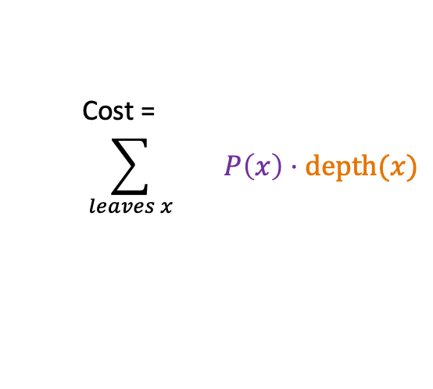
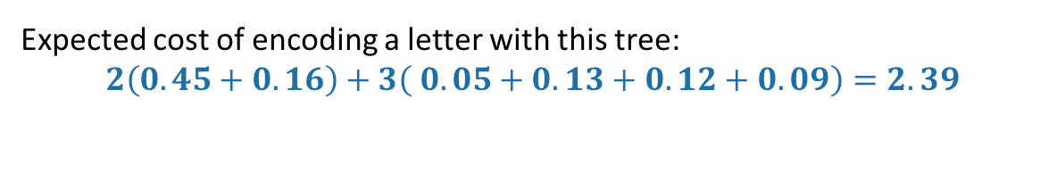
How good is a tree?
Imagine choosing a letter at random from the language.
Not uniformly random, but according to our histogram!
The cost of a tree is the expected length of the encoding of a random letter.
The depth in the tree is the length of the encoding
Cost =
$$\sum_{leaves x}{ P\left(x\right)⋅\text{depth}(x)}$$
0
1
P(x) is the probability of letter x
0
1
1
0
A: 45
D: 16
00
01
0
1
0
1
F:5
B:13
C:12
E:9
100
101
110
111
Expected cost of encoding a letter with this tree:
$$2\left(0.45+0.16\right)+3\left( 0.05+0.13+0.12+0.09\right)=2.39$$

Slide 91

Question
Given a distribution P on letters, find the lowest-cost tree, where
$$cost(tree)= \sum_{leaves x}{P\left(x\right)⋅\text{depth}(x)}$$
P(x) is the probability of letter x
The depth in the tree is the length of the encoding

Slide 92
Greedy algorithm
Greedily build sub-trees from the bottom up.
Greedy goal: less frequent letters should be further down the tree.

Slide 93
Solution greedily build subtrees, starting with the infrequent letters
14
0
1
A: 45
B:13
C:12
D: 16
E:9
F:5

Slide 94
Solution greedily build subtrees, starting with the infrequent letters
25
14
0
1
0
1
A: 45
B:13
C:12
D: 16
E:9
F:5

Slide 95
Solution greedily build subtrees, starting with the infrequent letters
30
1
25
14
0
0
1
0
1
A: 45
B:13
C:12
D: 16
E:9
F:5

Slide 96
Solution greedily build subtrees, starting with the infrequent letters
55
1
30
0
1
25
14
0
0
1
0
1
A: 45
B:13
C:12
D: 16
E:9
F:5

Slide 97
Solution greedily build subtrees, starting with the infrequent letters
100
1
55
1
30
0
0
1
25
14
0
0
1
0
1
A: 45
B:13
C:12
D: 16
E:9
F:5

Slide 98
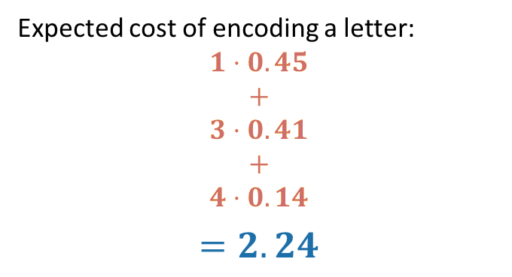
Solution greedily build subtrees, starting with the infrequent letters
100
Expected cost of encoding a letter:
$$1⋅0.45$$
$$+$$
$$3⋅0.41$$
$$+$$
$$4⋅0.14$$
$$=2.24$$
0
1
55
A: 45
0
1
0
30
25
0
0
1
1
C:12
D: 16
14
B:13
101
110
0
1
100
E:9
F:5
1110
1111

Slide 99
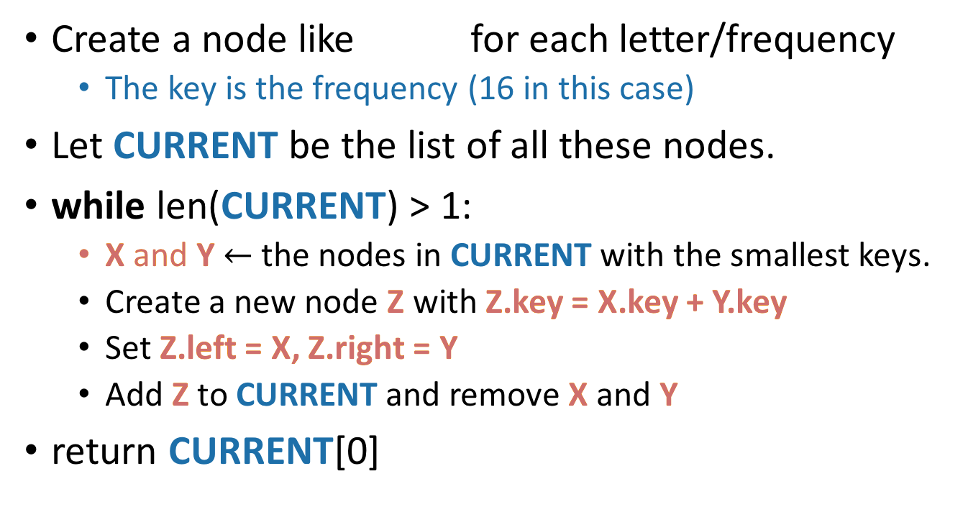
What exactly was the algorithm?
D: 16
Create a node like for each letter/frequency
The key is the frequency (16 in this case)
Let CURRENT be the list of all these nodes.
while len(CURRENT) > 1:
X and Y $←$ the nodes in CURRENT with the smallest keys.
Create a new node Z with Z.key = X.key + Y.key
Set Z.left = X, Z.right = Y
Add Z to CURRENT and remove X and Y
return CURRENT[0]
14
Z
0
1
A: 45
B:13
C:12
D: 16
F:5
E:9
X
Y

Slide 100
This is called Huffman Coding:
D: 16
Create a node like for each letter/frequency
The key is the frequency (16 in this case)
Let CURRENT be the list of all these nodes.
while len(CURRENT) > 1:
X and Y $←$ the nodes in CURRENT with the smallest keys.
Create a new node Z with Z.key = X.key + Y.key
Set Z.left = X, Z.right = Y
Add Z to CURRENT and remove X and Y
return CURRENT[0]
14
Z
0
1
A: 45
B:13
C:12
D: 16
F:5
E:9
X
Y

Slide 101
Does it work?
Yes.
We will sketch a proof here.
Same strategy:
Show that at each step, the choices we are making won’t rule out an optimal solution.
Lemma:
Suppose that x and y are the two least-frequent letters. Then there is an optimal tree where x and y are siblings.
14
0
1
A: 45
B:13
C:12
D: 16
E:9
F:5

Slide 102
Lemma proof idea
If x and y are the two least-frequent letters, there is an optimal tree where x and y are siblings.
Say that an optimal tree looks like this:
What happens to the cost if we swap x for a?
the cost can’t increase; a was more frequent than x, and we just made a’s encoding shorter and x’s longer.
Repeat this logic until we get an optimal tree with x and y as siblings.
The cost never increased so this tree is still optimal.
x
Lowest-level sibling nodes: at least one of them is neither x nor y
a

Slide 103
Lemma proof idea
If x and y are the two least-frequent letters, there is an optimal tree where x and y are siblings.
Say that an optimal tree looks like this:
What happens to the cost if we swap x for a?
the cost can’t increase; a was more frequent than x, and we just made a’s encoding shorter and x’s longer.
Repeat this logic until we get an optimal tree with x and y as siblings.
The cost never increased so this tree is still optimal.
Lowest-level sibling nodes: at least one of them is neither x nor y
x
y

Slide 104
Huffman Coding Works (idea)
Show that at each step, the choices we are making won’t rule out an optimal solution.
Lemma:
Suppose that x and y are the two least-frequent letters. Then there is an optimal tree where x and y are siblings.
That’s enough to show that we don’t rule out optimality on the first step.
14
0
1
A: 45
B:13
C:12
D: 16
E:9
F:5

Slide 105
Huffman Coding Works (idea)
Show that at each step, the choices we are making won’t rule out an optimal solution.
Lemma:
Suppose that x and y are the two least-frequent letters. Then there is an optimal tree where x and y are siblings.
That’s enough to show that we don’t rule out optimality on the first step.
To show that continue to not rule out optimality once we start grouping stuff…
30
1
25
14
0
0
0
1
1
A: 45
B:13
C:12
D: 16
E:9
F:5

Slide 106
Huffman Coding Works (idea)
To show that continue to not rule out optimality once we start grouping stuff…
The basic idea is that we can treat the “groups” as leaves in a new alphabet.
30
1
25
14
0
0
0
1
1
A: 45
B:13
C:12
D: 16
E:9
F:5

Slide 107
Huffman Coding Works (idea)
To show that continue to not rule out optimality once we start grouping stuff…
The basic idea is that we can treat the “groups” as leaves in a new alphabet.
Then we can use the lemma from before.
30
1
DEF:30
25
14
BC:25
0
0
0
1
1
A: 45
B:13
C:12
D: 16
E:9
F:5

Slide 108
What have we learned?
*If all we care about is number of bits.
ASCII isn’t an optimal way* to encode English, since the distribution on letters isn’t uniform.
Huffman Coding is an optimal way!
To come up with an optimal scheme for any language efficiently, we can use a greedy algorithm.
To come up with a greedy algorithm:
Identify optimal substructure
Find a way to make choices that won’t rule out an optimal solution.
Create subtrees out of the smallest two current subtrees.

Slide 109
Recap I
Greedy algorithms!
Five examples:
Substructure
Matroid
Activity Selection/Interval Scheduling
Interval Partitioning
Maximum Lateness Minimization Scheduling
Sum Penalty Minimization Scheduling
Huffman Coding

Slide 110
Recap II
Greedy algorithms!
Often easy to write down
But may be hard to come up with and hard to justify
The natural greedy algorithm may not always be correct.
A problem is a good candidate for a greedy algorithm if:
it has optimal substructure
that optimal substructure is REALLY NICE
solutions depend on just one other sub-problem.

